Slide 1


HOSTOPIA · PARTNER BRIEFING
Online Marketing Center.
White-label digital marketing products for service providers who want to grow revenue and retain customers.
BEHIND THE BRANDS
that power small business.™

Slide 2

INTRODUCTION
01 / 24
About Hostopia.
01
White-label platform
Resell under your own brand, end-to-end.
A leading provider of private-label web services and digital marketing tools, built for service providers who want to grow their business and retain customers.
02
Partner-focused
Built for telcos, MSPs, cablecos, and service providers.
03
Revenue growth
Drive incremental revenue with value-added services.
04
Customer retention
Increase stickiness and reduce churn.
ONLINE MARKETING CENTER

Slide 3




THE OPPORTUNITY
02 / 24
The partner opportunity.
Four ways Hostopia creates value for your business and the SMBs you serve.
01
02
03
04
Revenue generation
Customer retention
Your brand
Competitive edge
Add high-margin digital marketing services to your portfolio without development cost.
Increase customer lifetime value and reduce churn with essential business tools.
A 100% white-label solution — your identity shows up at every customer touchpoint.
Differentiate with a comprehensive marketing solution your competitors don't have.
h
ONLINE MARKETING CENTER

Slide 4
THE PRODUCT LINE
03 / 24
Five products, one upgrade path.
Each tier builds on the last — so partners can upsell customers as their needs grow.
01 · STARTER
02 · ESSENTIALS
03 · TRUST
04 · BOOST
05 · 360 SUITE
Brand & competitor monitoring
+ 3-directory sync & AI posting
+ up to 30 directories & reputation
+ full social media management
+ paid ad management
Real-time alerts for mentions, reviews, and competitor moves.
Google, Facebook, Instagram + AI-generated content.
Full local listings plus review management tools.
AI-driven posting and ads across Meta, LinkedIn, X.
Google Ads and SEA for complete coverage.
.
ONLINE MARKETING CENTER

Slide 5

PRODUCT OVERVIEW
04 / 24
STARTER
STARTER
WHAT'S INCLUDED
Brand & competitor monitoring.
Brand Monitoring
Track online mentions and business activity.
Competitor Insights
Monitor competitor rankings, ads, and promotions.
Review Notifications
Get alerted the moment new reviews appear.
A real-time awareness layer — so customers always know when their business, their reviews, or their competitors move.
Instant Alerts
Email and in-app notifications for all activities.
PARTNER VALUE
A perfect entry-level bundle. Offer free or low-cost to spark customer engagement and awareness of their online presence.
PRODUCT 01 • STARTER
Real-time awareness of brand, reviews, and competitors.
STARTER · PRODUCT OVERVIEW

Slide 6




PRODUCT 01 · STARTER
05 / 24
Monitor what matters.
REAL-TIME
UNIFIED
INSIGHT
GROWTH
Instant notifications
Customized dashboard
Competitor tracking
Upgrade triggers
Customers are alerted the moment their business or competitors are mentioned, ranked, or reviewed.
A single feed across search, social, directories, and web mentions — everything in one place.
Track up to three competitors to stay ahead of rankings, pricing, and campaign moves.
In-app prompts encourage users to upgrade to higher tiers for deeper functionality.
.
STARTER · MONITOR WHAT MATTERS

Slide 7

PRODUCT OVERVIEW
06 / 24
ESSENTIALS
MARKETING ESSENTIALS
WHAT'S ADDED
Establish a digital footprint.
Google Business Profile
Connect and manage Google Business listings.
Core Directory Sync
Sync profiles to Google, Facebook, and Instagram.
SEO Essentials
Track key SEO metrics with integrated scoring.
Everything in Starter, plus profile management, essential SEO, and social tools that get customers live on day one.
AI Post Generator
Create AI-generated content for Meta and Google.
PARTNER VALUE
Ideal for bundling with hosting or website builder packages. Gets customers live quickly and builds their presence immediately.
PRODUCT 02 • ESSENTIALS
The first real digital presence — profiles, SEO, AI posting.
ESSENTIALS · PRODUCT OVERVIEW

Slide 8




PRODUCT 02 · ESSENTIALS
07 / 24
Build digital presence.
LISTINGS
ANALYTICS
AI
REVIEWS
Top-listings management
SEO performance tracking
AI-powered content
Review management
Coordinate business info across Google, Facebook, and Instagram from one dashboard.
Monitor website performance with integrated Google Analytics and SEO scoring.
Generate social posts and Google Business updates with AI assistance.
Monitor reviews and use AI to auto-reply on Facebook, Instagram, and Google.
ESSENTIALS · BUILD DIGITAL PRESENCE

Slide 9
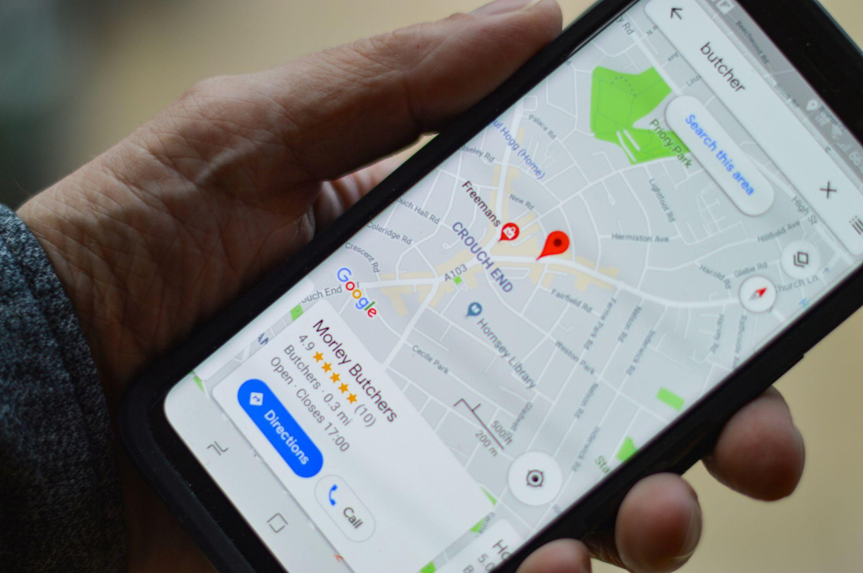
PRODUCT OVERVIEW
08 / 24
TRUST
TRUST
WHAT'S ADDED
Build trust in local search.
Extended Directory Sync
1-click publishing to 30+ relevant local directories.*
Review Booster
Send bulk invitations to collect customer feedback.
Everything in Essentials, plus comprehensive local directory listings and advanced reputation management.
Reputation Widget
Display live reviews on customer websites.
Reputation Benchmarking
Compare ratings against local competitors.
*Directory coverage varies by country.
PARTNER VALUE
A strong standalone product or marketing bundle — helps customers dominate local search and build trust through reviews.
PRODUCT 03 • TRUST
Local directory coverage and reputation management at scale.
TRUST · PRODUCT OVERVIEW

Slide 10




PRODUCT 03 · TRUST
09 / 24
LOCAL DIRECTORY POWER
Dominate the local map.
Sync business information to every relevant online directory with a single click.
ONBOARD
REACH
RANKING
SIGNAL
Quick profile creation
Extensive coverage
SEO boost
Real-time monitoring
Step-by-step prompts guide users to a compelling business profile.
Publish automatically to directories tailored by location and industry.
Well-maintained directories improve local SEO rankings over time.
Track local events and get competitor insights via instant alerts.
TRUST · LOCAL DIRECTORY POWER

Slide 11




PRODUCT 03 · TRUST
10 / 24
REPUTATION MANAGEMENT
Protect and grow the brand.
Intelligent review management and customer feedback tools that shape how a business is seen.
HUB
AI
WIDGET
BENCHMARK
Review centralization
Tone-matched replies
Review collection
Competitor comparison
Manage reviews from Google, Facebook, and more in one unified view.
AI-drafted responses save hours while keeping the brand voice consistent.
An embeddable widget displays live reviews directly on customer websites.
Benchmark ratings against local competition with reputation insights.
TRUST · REPUTATION MANAGEMENT

Slide 12

PRODUCT OVERVIEW
11 / 24
BOOST
BOOST
WHAT'S ADDED
Full-stack social media.
Multi-Platform Posting
Schedule to Facebook, Instagram, LinkedIn, and X from one view.
AI Content Creation
Generate posts and eye-catching visuals with AI.
Everything in Trust, plus AI-driven social management across Meta, LinkedIn, and X to drive engagement and growth.
Social Media Ads
Turn top-performing posts into ads instantly.
Performance Analytics
Track engagement and content performance across channels.
PARTNER VALUE
Standalone or bundled. For customers ready to actively engage audiences and grow social media presence professionally.
PRODUCT 04 • BOOST
Full-stack social — posting, ads, and audience growth.
BOOST · PRODUCT OVERVIEW

Slide 13




PRODUCT 04 · BOOST
12 / 24
Complete social media management.
POSTING
INBOX
CALENDAR
TRAFFIC
AI-powered publishing
Comment management
Content calendar
Boost campaigns
Plan, schedule, and get instant content ideas for every major platform.
View and respond to comments across platforms with AI-assisted replies.
Plan multiple posts in advance with a calendar view and automated scheduling.
Launch social ads with best-performing posts in just a few clicks.
BOOST · COMPLETE SOCIAL MANAGEMENT

Slide 14
PRODUCT OVERVIEW
13 / 24
360 SUITE
360 SUITE
WHAT'S ADDED
The complete marketing stack.
Google Ads Setup
Launch paid search campaigns in a few easy steps.
AI-Generated Ads
Automatically create compelling headlines and descriptions.
Everything in Boost, plus search engine advertising for complete digital marketing coverage — the flagship tier.
Budget Control
Full spending control — adjust, pause, or scale at any time.
Competitor Analytics
AI-driven insights into competitor advertising tactics.
PARTNER VALUE
The premium offering. For customers who want maximum visibility, traffic, and growth — your highest revenue potential.
PRODUCT 05 • 360 SUITE
The complete marketing stack, including paid search.
360 SUITE · PRODUCT OVERVIEW

Slide 15



PRODUCT 05 · 360 SUITE
14 / 24
SEARCH ENGINE ADVERTISING
Targeted traffic, top placement.
Strategic paid ads on Google that put customers above the fold, where the clicks are.
SETUP
VISIBILITY
AI
REPORTING
Quick campaign launch
Enhanced reach
Optimized creative
Detailed analytics
Launch Google Ads campaigns in minutes with guided workflows.
Boost visibility for events, posts, and offers with targeted campaigns.
AI generates and selects top-performing ad headlines and descriptions.
In-depth insights on ad performance and overall campaign effectiveness.
360 SUITE · SEARCH ENGINE ADVERTISING

Slide 16
PRODUCT MATRIX
15 / 24
Feature comparison.
Capabilities at a glance — part one of two.
Capability
STARTER
ESSENTIALS
TRUST
BOOST
360 SUITE
Brand Monitoring
●
●
●
●
●
Competitor Insights
●
●
●
●
●
Review Monitoring
●
●
●
●
●
Google Business Profile Sync
—
●
●
●
●
SEO Reports & Analytics
—
LIMITED
LIMITED
●
●
AI-Driven SEO Tasks
—
TEASER
TEASER
●
●
Social Media Posts
—
●
●
●
●
FEATURE COMPARISON · 1 OF 2

Slide 17
PRODUCT MATRIX
16 / 24
Feature comparison, cont.
Advanced capabilities unlocked at higher tiers.
Capability
STARTER
ESSENTIALS
TRUST
BOOST
360 SUITE
Extended Directory Sync (30+)
—
—
●
●
●
Review Booster
—
—
●
●
●
Reputation Widget
—
—
●
●
●
Automated Review Replies
—
—
●
●
●
Multi-Platform Social Posting
—
—
—
●
●
AI Image Generator
—
—
—
●
●
Social Media Ads
—
—
—
●
●
Google Ads Campaigns
—
—
—
—
●
FEATURE COMPARISON · 2 OF 2

Slide 18
CUSTOMER JOURNEY
17 / 24
The natural upsell journey.
Each tier builds on the last — a clear upgrade path as customers' businesses grow.
03 · TRUST
04 · BOOST
05 · 360 SUITE
Dominate locally
Engage & grow
Go all-in
01 · STARTER
02 · ESSENTIALS
Ready for complete digital marketing with paid advertising.
Discover
Activate
Wants to own local search and build reputation through reviews.
Needs professional social management to engage and grow the audience.
Customer monitors their online presence and competition.
Ready to act — manage profiles and start basic SEO.
THE NATURAL UPSELL JOURNEY

Slide 19





THE PARTNERSHIP
18 / 24
Why partner with Hostopia.
100%
$0
TRUSTED
ALWAYS
White label
No development cost
Proven platform
Continuous innovation
Resell under your own brand with complete customization — your logo, your colors, your identity.
Launch sophisticated digital marketing services without building from scratch or hiring developers.
Award-winning rankingCoach technology trusted by thousands of businesses worldwide.
AI-powered features, regular updates, and new capabilities delivered automatically.
WHY PARTNER WITH HOSTOPIA

Slide 20
THE PARTNERSHIP
19 / 24
What you gain as a partner.
01
Recurring revenue stream
A subscription model creates predictable monthly revenue across your entire customer base.
02
Higher lifetime value
Four strategic advantages that compound with every customer you onboard.
Essential business tools reduce churn and significantly increase customer retention.
03
Competitive differentiation
Stand out from competitors offering only basic hosting or communication services.
04
Simplified operations
A single platform integrates with your existing systems — minimal operational overhead.
WHAT YOU GAIN AS A PARTNER

Slide 21




GO-TO-MARKET
20 / 24
Target customers.
Small and medium businesses across every industry who need to establish, manage, and grow their online presence.
STARTER
ESSENTIALS
TRUST / BOOST
360 SUITE
New businesses
Local businesses
Growing businesses
Established businesses
Just getting started online — need brand awareness and basic digital presence.
Restaurants, shops, services — want to be found locally and manage reviews.
Ready to invest in marketing — need social management and advertising.
Want a complete digital marketing solution to maximize growth and ROI.
TARGET CUSTOMERS

Slide 22
OPERATIONS
21 / 24
Seamless integration.
SSO
Single sign-on integration
Customers move from your platform to Online Marketing Center with one click.
Hostopia integrates with your existing systems so customers manage every marketing service in one place.
UI
Branded customer portal
Your logo, colors, and domain — fully white-labeled end to end.
WHITE LABEL, TRULY INVISIBLE
AUTO
Automated provisioning
Your customers see your brand at every touchpoint. Hostopia works behind the scenes so you stay front and center.
New customers and plan changes flow through automatically, no manual work.
API
API access for custom work
Integrate deeply with your internal tools, reporting, or billing stack.
SEAMLESS INTEGRATION

Slide 23




OPERATIONS
22 / 24
We support your success.
Comprehensive partner support to help you sell and service these products with confidence.
01
02
03
04
Sales enablement
Marketing resources
Technical support
Ongoing training
Training materials, product demos, and sales collateral for your team.
Co-branded marketing materials, email templates, and campaign assets.
A dedicated partner support team and technical documentation for integration.
Regular webinars, product updates, and best-practice sharing sessions.
PARTNER SUPPORT

Slide 24
NEXT STEP
23 / 24
LET'S GET STARTED
Let's book a demo today.
Partner with Hostopia to offer comprehensive white-label digital marketing solutions that drive revenue, retention, and growth.
NEXT STEP
Contact your Hostopia account manager to begin.
ONLINE MARKETING CENTER · PARTNER BRIEFING

